Slide 1
Study Advisory Working Group
June 8, 2021
Notes:
Cover slide

Slide 2
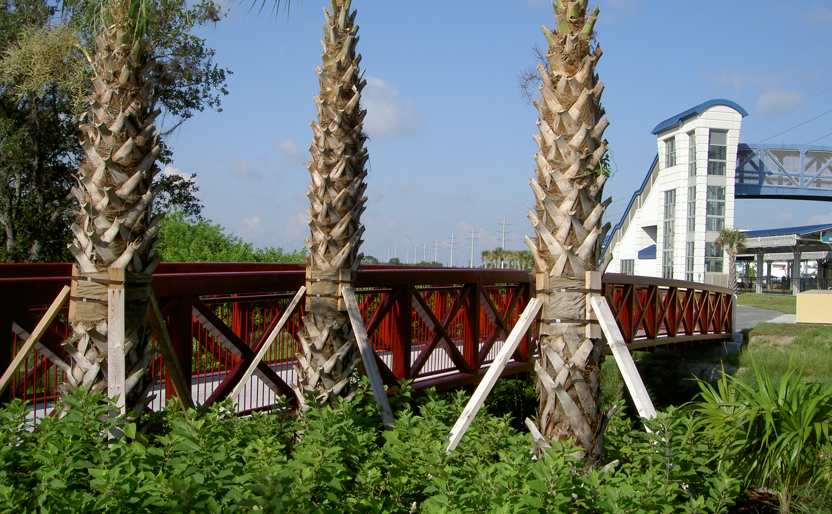
MISSION
To collaboratively plan, prioritize, and fund the transportation system
VISION
A safe, efficient, and connected multimodal transportation system.

Slide 3
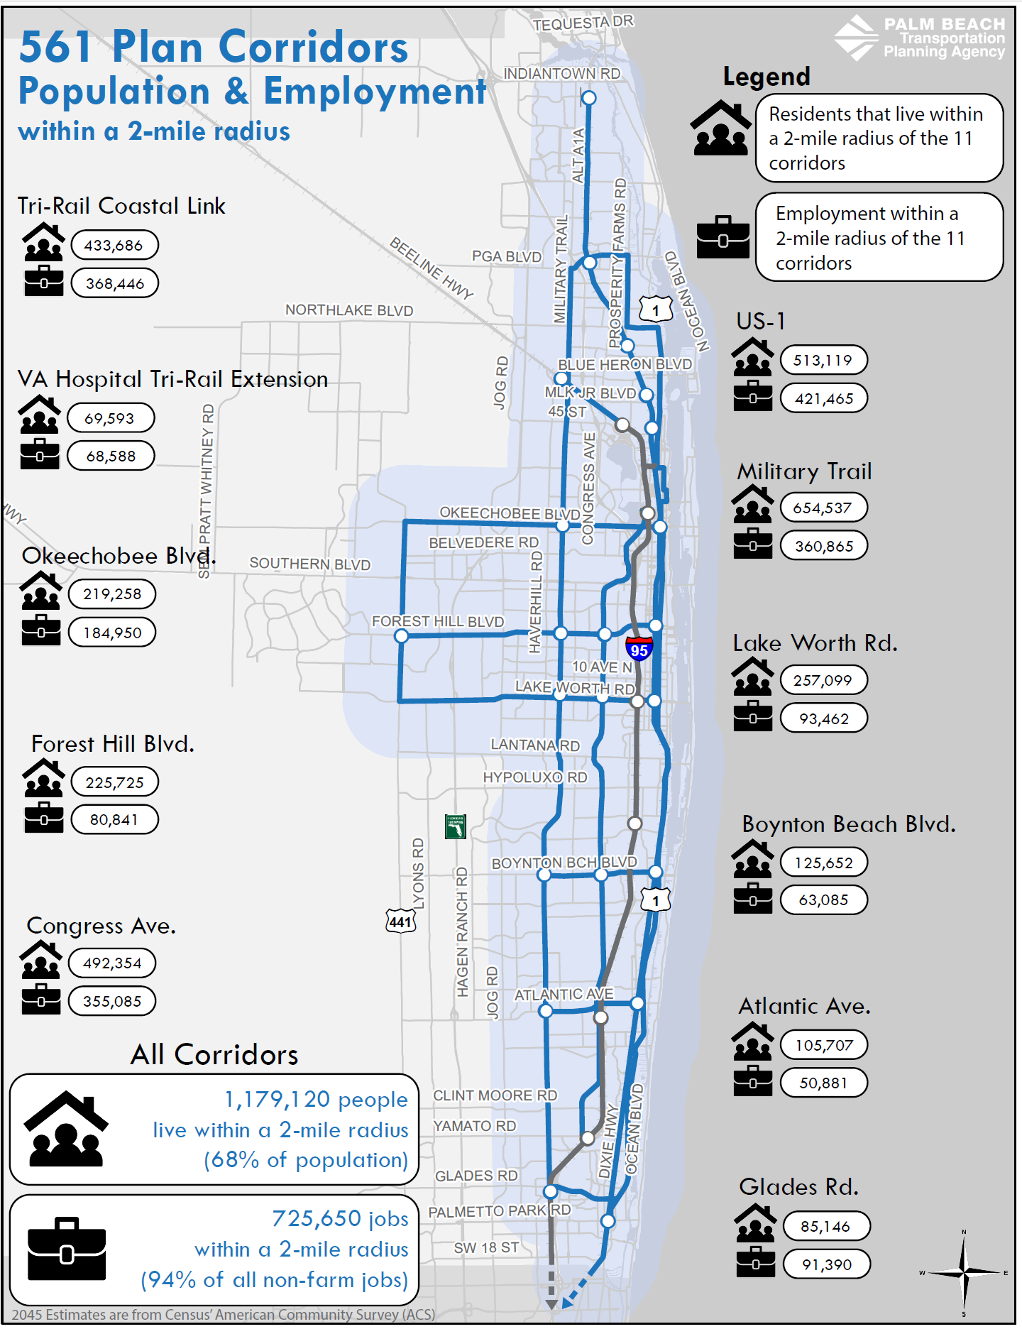
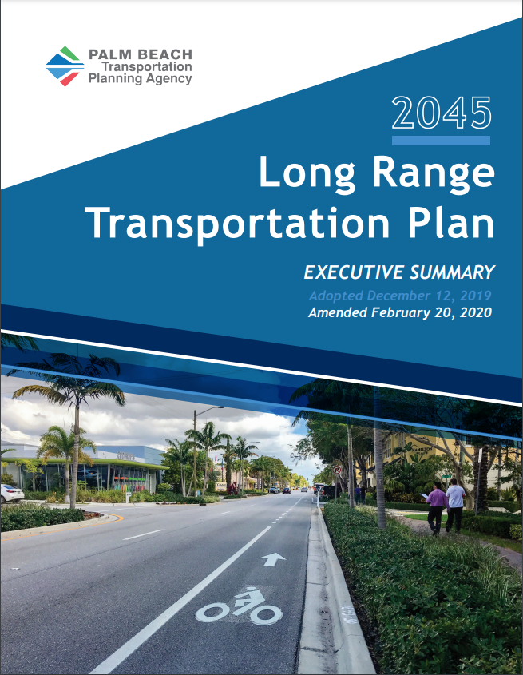
2045 Long Range Transportation Plan – 561 Plan
Five (5) N/S Corridors
Tri-Rail, Coastal Link
US 1, Congress Ave, Military Trail
Six (6) E/W Corridors
Okeechobee Blvd, Forest Hill Blvd, Lake Worth Rd
Boynton Beach Blvd, Atlantic Ave, Glades Rd
One (1) Connected System
Notes:
The TPA has a 25-year LRTP that is updated every 5 years – the TPA adopted the 2045 LRTP update in December 2019 and identified a network of corridors desired to evaluate for enhanced transit and pedestrian and bicycle facilities to create a safe, efficient and connected network along these corridors – referred to the 561 plan…
Enhanced Transit = Frequent limited stop service, branded vehicles and stations, level boarding, off-board fare payment, transit signal priority
These corridors capture 68% of people and 94% of all non-farm jobs in the county within 2 miles today and in the future with approximately 1.5 m today and 1.8 million in the future. They are also part of the Miami-Urbanized Area’s Regional Long Range Transportation Plan connecting to enhanced transit corridors throughout the region in Broward and Miami-Dade Counties.
Population (2017):
Palm Beach: 1.471 M
Broward: 1.936 M
Miami-Dade: 2.752 M
Total: 6.159 M
By 2045:
Palm Beach: 1,811,000
Broward: 2,290,500
Miami-Dade: 3,523,500
Total: 7.625 M

Slide 4
Meeting Agenda
Okeechobee Blvd & SR 7 Multimodal Corridor Study
Study Purpose & Limits
Study Components
Public & Stakeholder Engagement
Study Timeline
Notes:
Changed font color to be consistent throughout presentation

Slide 5
Study Advisory Working Group (SAWG)
Participate in SAWG meetings
Provide input & share information
Promote public participation
FDOT
Palm Tran
Palm Beach County
West Palm Beach
Royal Palm Beach
Wellington
Central Chamber of Commerce
Chamber of Commerce of the Palm Beaches
1
2
3

Slide 6
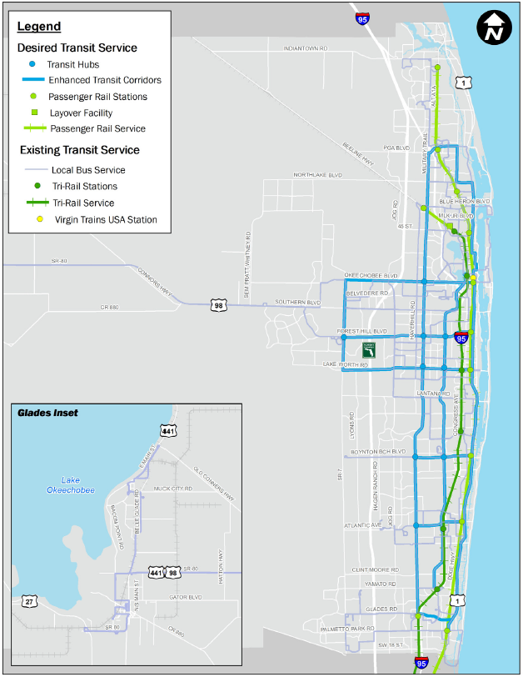
Study Purpose
Evaluate & Recommend Alternatives
Pedestrian + Bicycle Facilities
Transit Service
Transit Supportive Land Uses
Single Occupancy Vehicles
Safe - Efficient - Connected

Slide 7
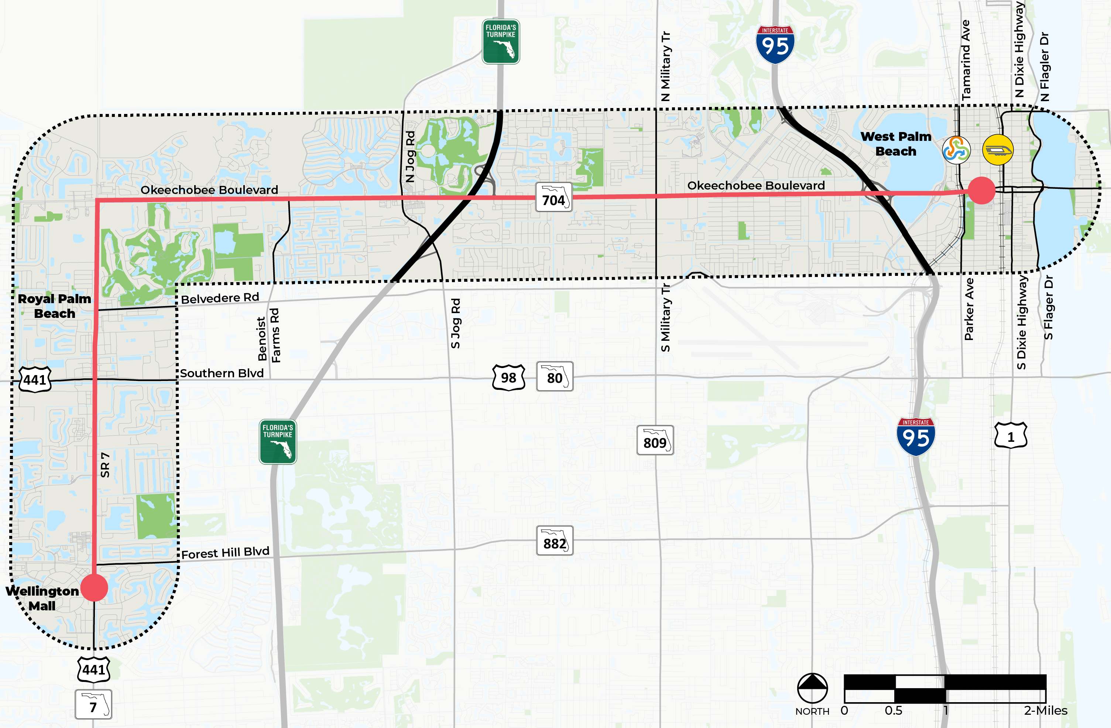
Study Limits
42,000 Residents
14,000
Households
46,000
Jobs
Legend:
Study Corridors
(within 0.5mile of corridor)
Study Beginning/End Points
(Wellington Mall to Rosemary Square)

Slide 8
Study Components
Land Use & Economic Development Analysis
Transit Analysis
Roadway Analysis
Health Impact Assessment
Public & Stakeholder Engagement

Slide 9
Transit & Roadway Analysis
No-build/No-action
Mixed traffic bus with limited stops
Business Access and Transit (BAT) curbside lanes
Center-platform dedicated-lane Bus Rapid Transit (BRT)
Curbside dedicated-lane BRT
Center-platform dedicated-lane Light Rail Transit (LRT)
Elevated grade-separated LRT
Environmental Assessment
Evaluation of Conceptual Alternatives
Ridership Forecasting
Costs Analysis
Roadway Analysis -> Renderings
Prioritization Analysis -> Recommended Alternative
Right-of-Way Impacts of Recommended Alternative

Slide 10
Land Use & Economic Development Analysis
New Comm./ Office
Housing
Station Area Planning
Jobs Created
New Revenue
Parking

Slide 11
Health Impact Assessment (HIA)
Brings together scientific data, health expertise, and public input to identify potential health effects of proposed laws, regulations, projects, & programs
Influences potential project alternatives by considering effects on health and the built environment
Proposes recommendations on how to improve potential policies and regulations
Includes monitoring and evaluation metrics to track the changes the project or policy will have in the community

Slide 12
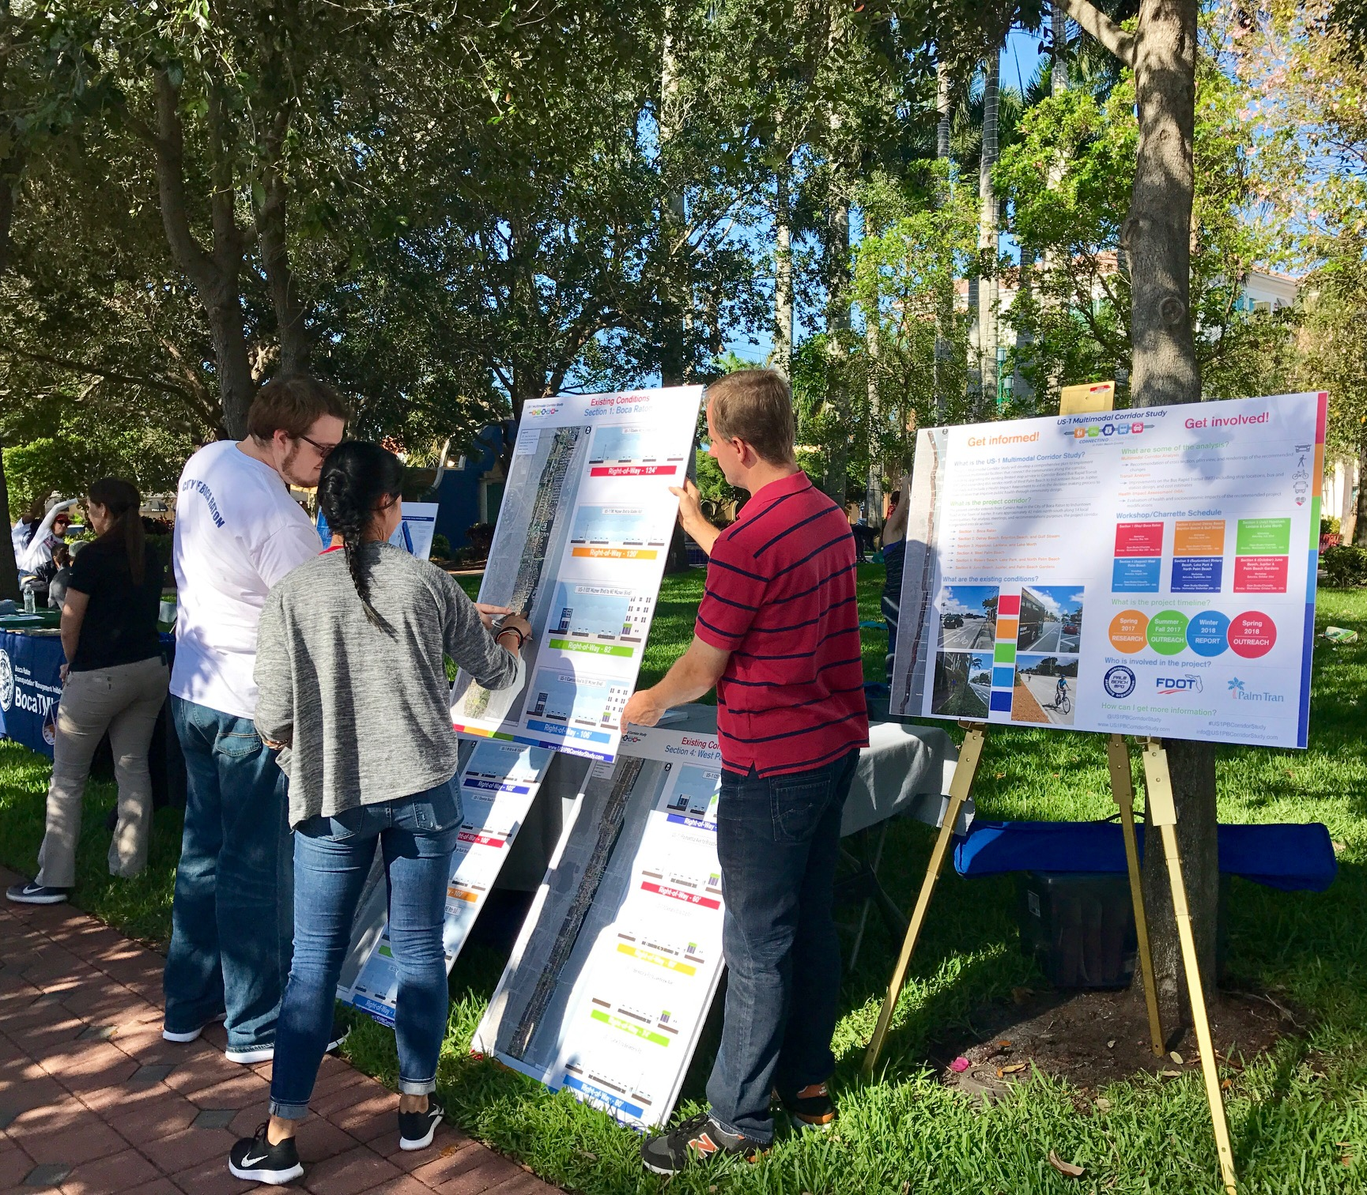
Public & Stakeholder Engagement
Public & Stakeholder Engagement
Stakeholder Advisory Working Group
Land Use & Economic Development
Interactive Website
Public Workshops
Key Stakeholder Interviews
HIA Working Group

Slide 13
Study Timeline
SPRING 2021
1st SAWG & HIA Meetings;
Stakeholder & Field Interviews
SUMMER 2021
2nd SAWG & HIA Meetings;
1st Public Outreach Event
FALL 2021
3rd SAWG & HIA Meetings;
2nd Public Outreach Event
WINTER 2021/22
4th SAWG & HIA Meetings;
3rd Public Outreach Event

Slide 14
SAWG Meeting Dates
TUESDAY
June 8
3 – 4 PM
THURSDAY
July 22
3 – 4 PM
THURSDAY
Oct 14
3 – 4 PM
WEDNESDAY
Jan 26
3 – 4 PM

Slide 15
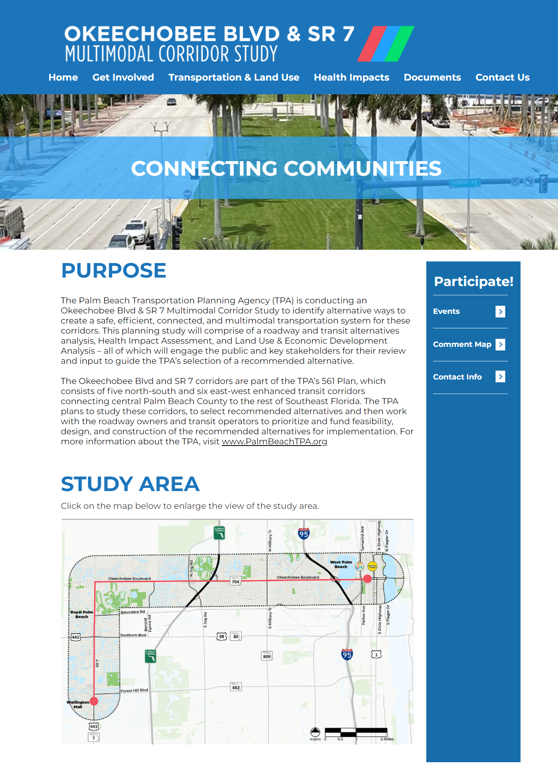
Next Steps
Project Team working on:
Transit & roadway analysis
Interactive online survey
Key stakeholder interviews
Public Engagement
SAWG meeting on July 22
Visit: PalmBeachTPA.org/Okee

Slide 16
Questions?
James Rinehart
JRinehart@PalmBeachTPA.org
(561) 725-0804

