Slide 1
SAWG Meeting #2
July 22, 2021

Slide 2
Meeting Overview
Study Purpose & Limits Recap
Economic Development and Land Use Updates
Health Impact Assessment Updates
Transit and Roadway Updates
Discussion
Timeline & Next Steps
2

Slide 3
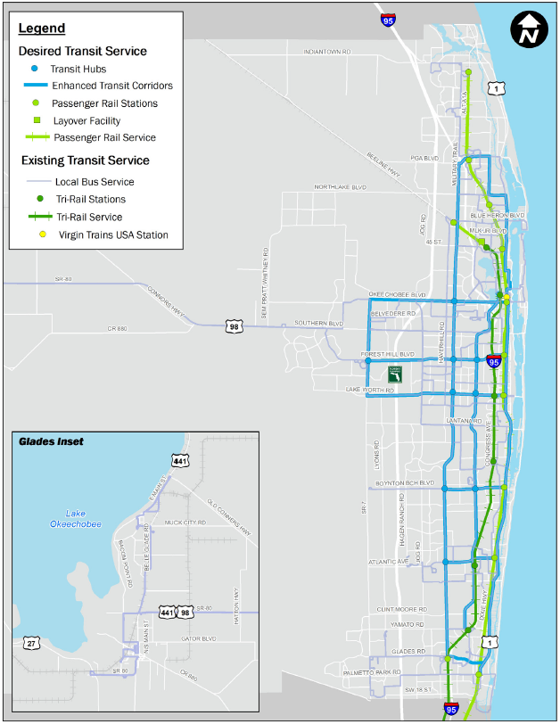
Study Purpose
Evaluate & Recommend Alternatives
Pedestrian + Bicycle Facilities
Transit Service
Transit Supportive Land Uses
Single Occupancy Vehicles
Safe - Efficient - Connected

Slide 4
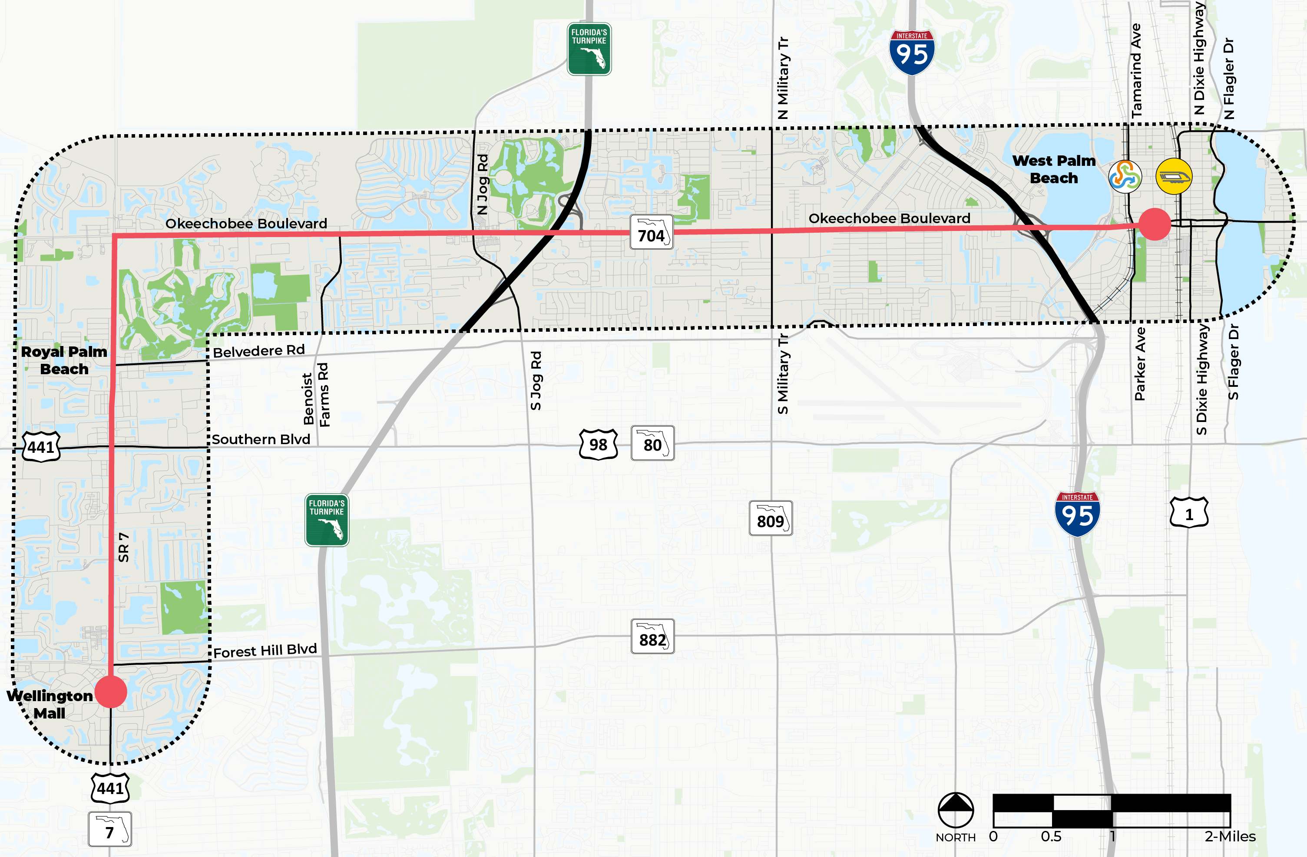
Study Limits
42,000 Residents
14,000
Households
46,000
Jobs
Legend:
Study Corridors
(within 0.5 mile of corridor)
Study Beginning/End Points
(Wellington Mall to Rosemary Square)

Slide 5
Issues and Opportunities
Data gathering helps inform the understanding of Issues and Opportunities
Context
Land Use
Taxable Value
Health
Traffic
Transit
Safety
Facilities

Slide 6
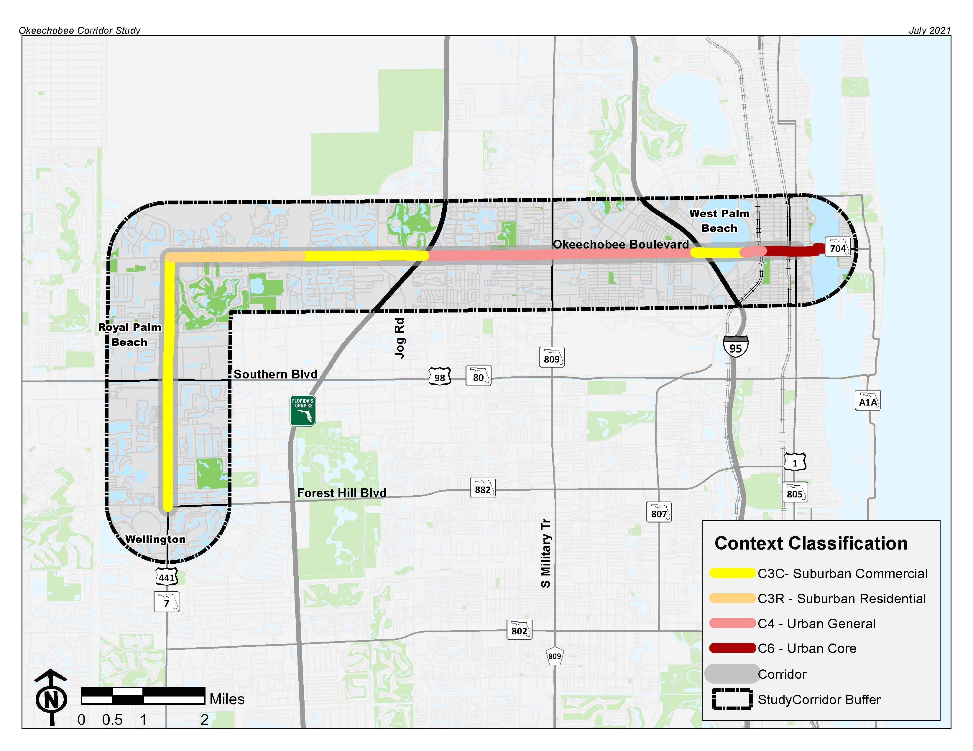
Context
Three distinct segments emerge
West of Turnpike
Suburban
Turnpike to I-95
Urban General
East of I-95
Clear Lake segment is de facto Suburban (no fronting uses)
Urban Core east of Tamarind Ave

Slide 7
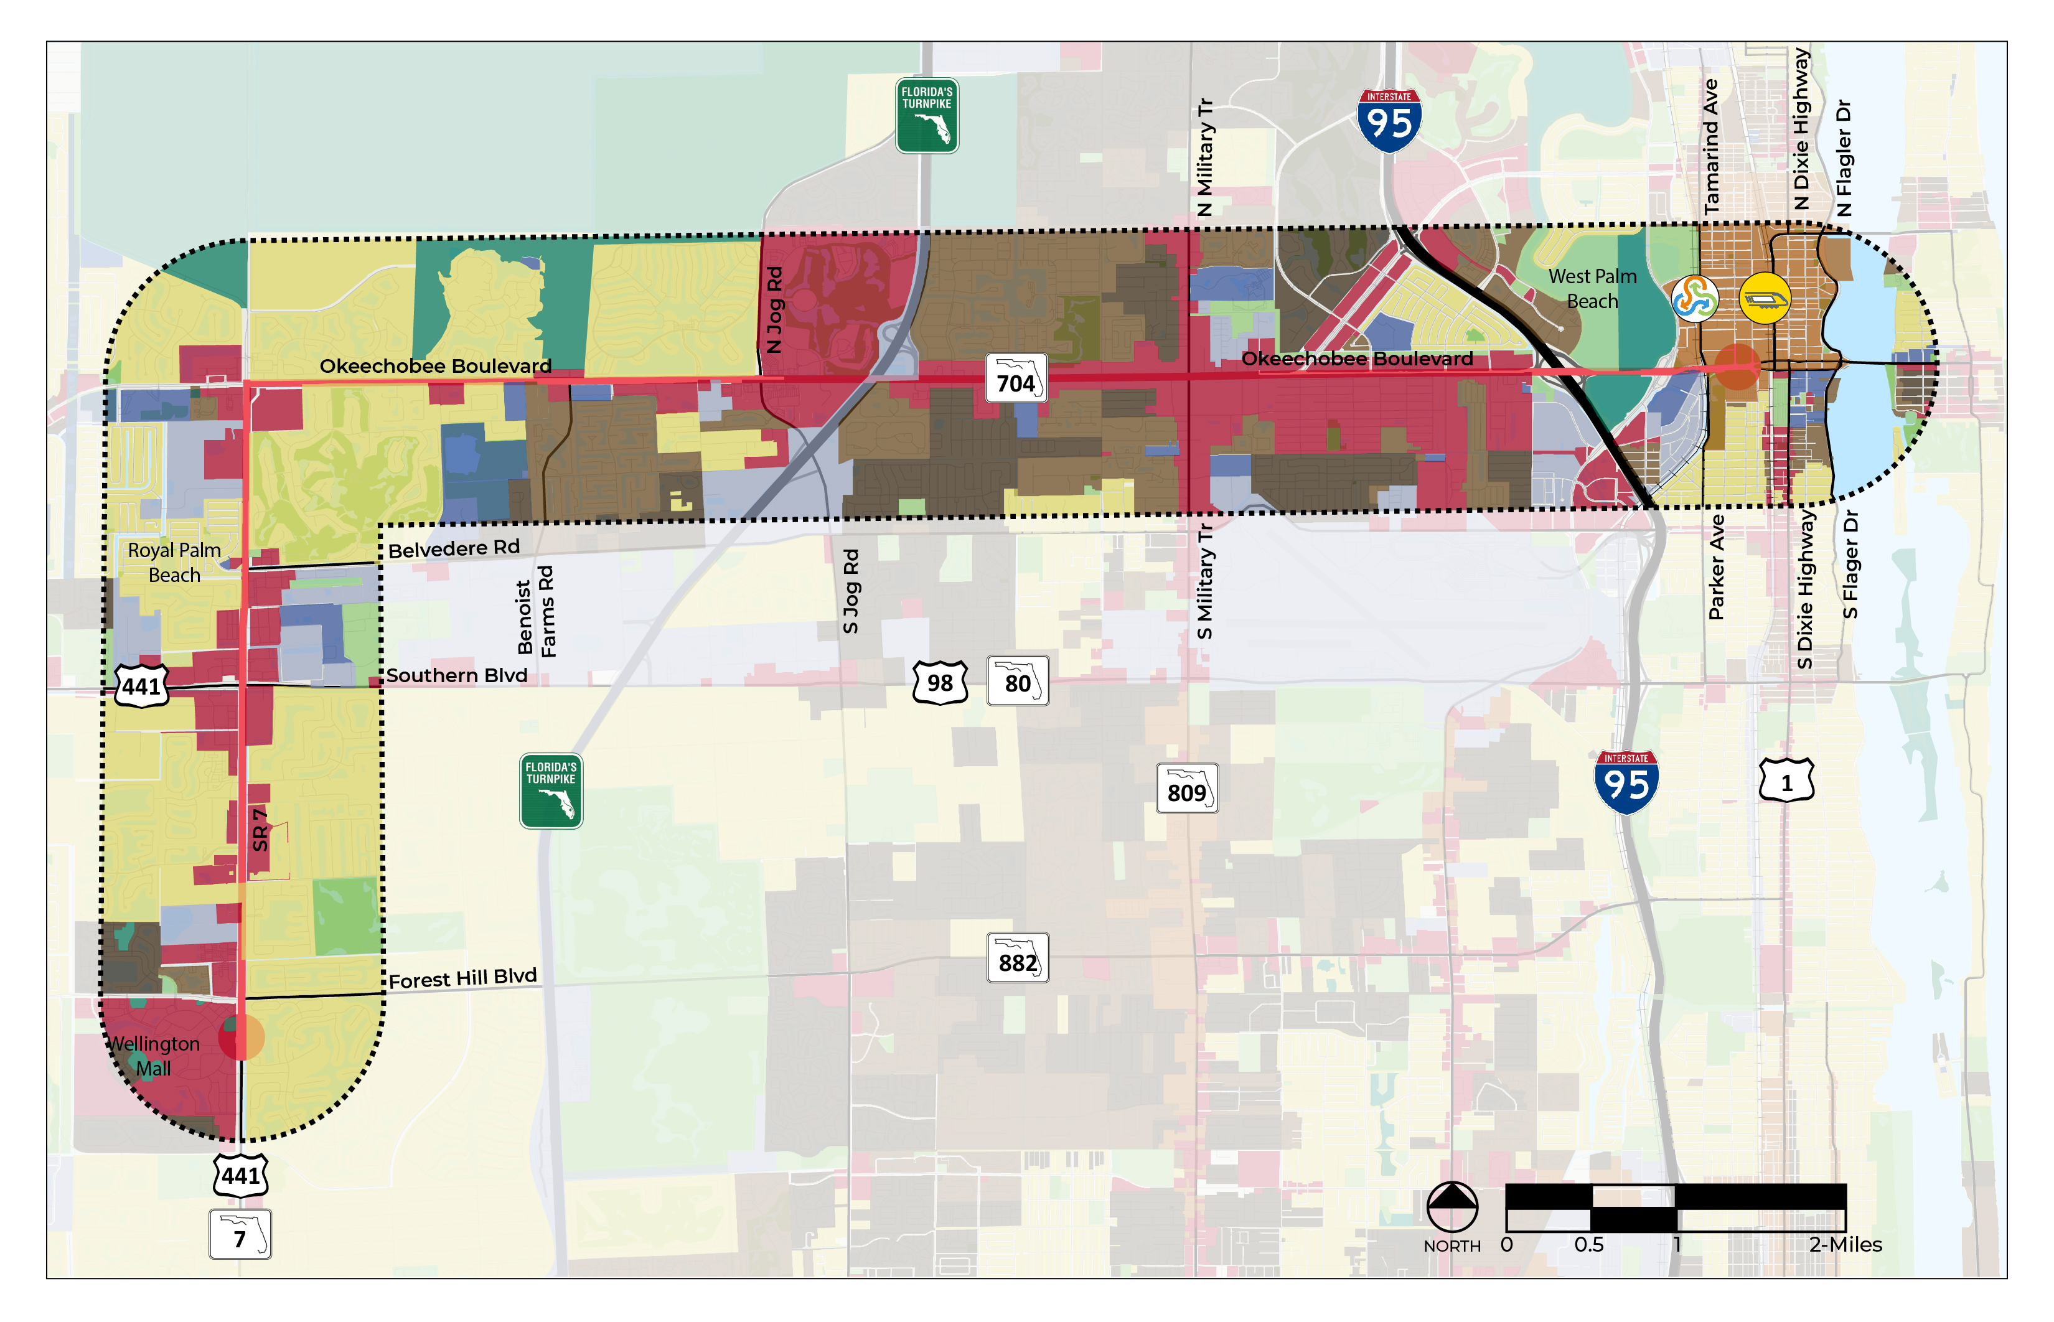
Future Land Uses
Legend
Conservation
Open Space
Low Density Residential
Med Density Residential
High Density Residential
Mixed Use
Commercial
Institutional
Industrial
7
Notes:
.

Slide 8
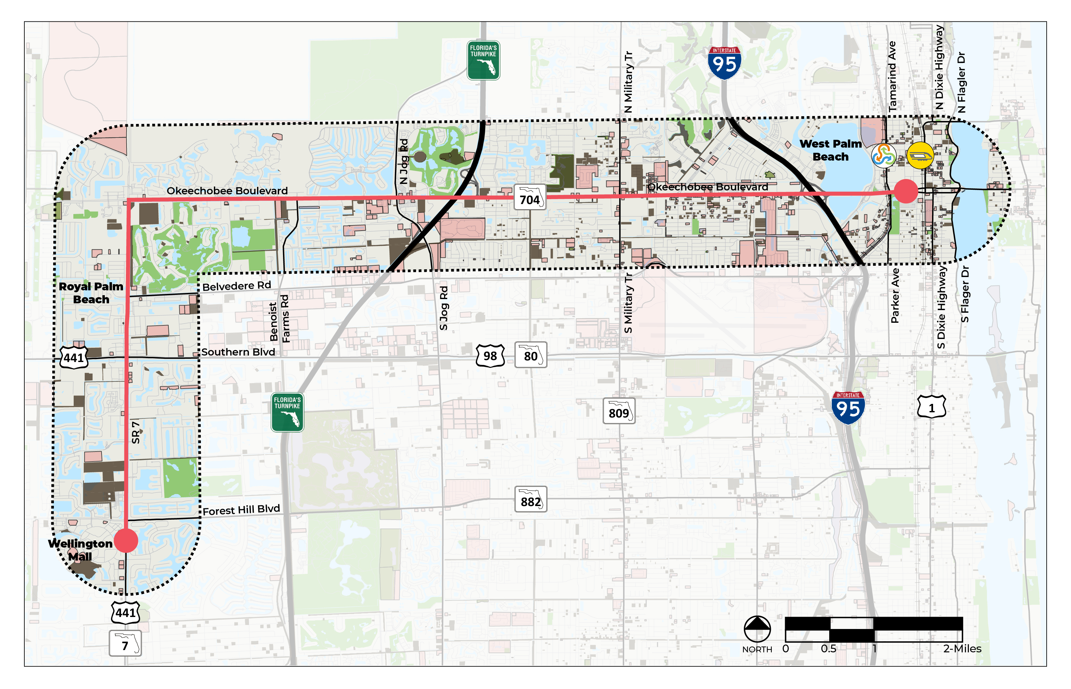
Utilization
Legend
Underutilized
Vacant
*Calculated as (Building Value) divided by (Building and Land Value)
**Parcels shown fall under 40% utilization
8

Slide 9
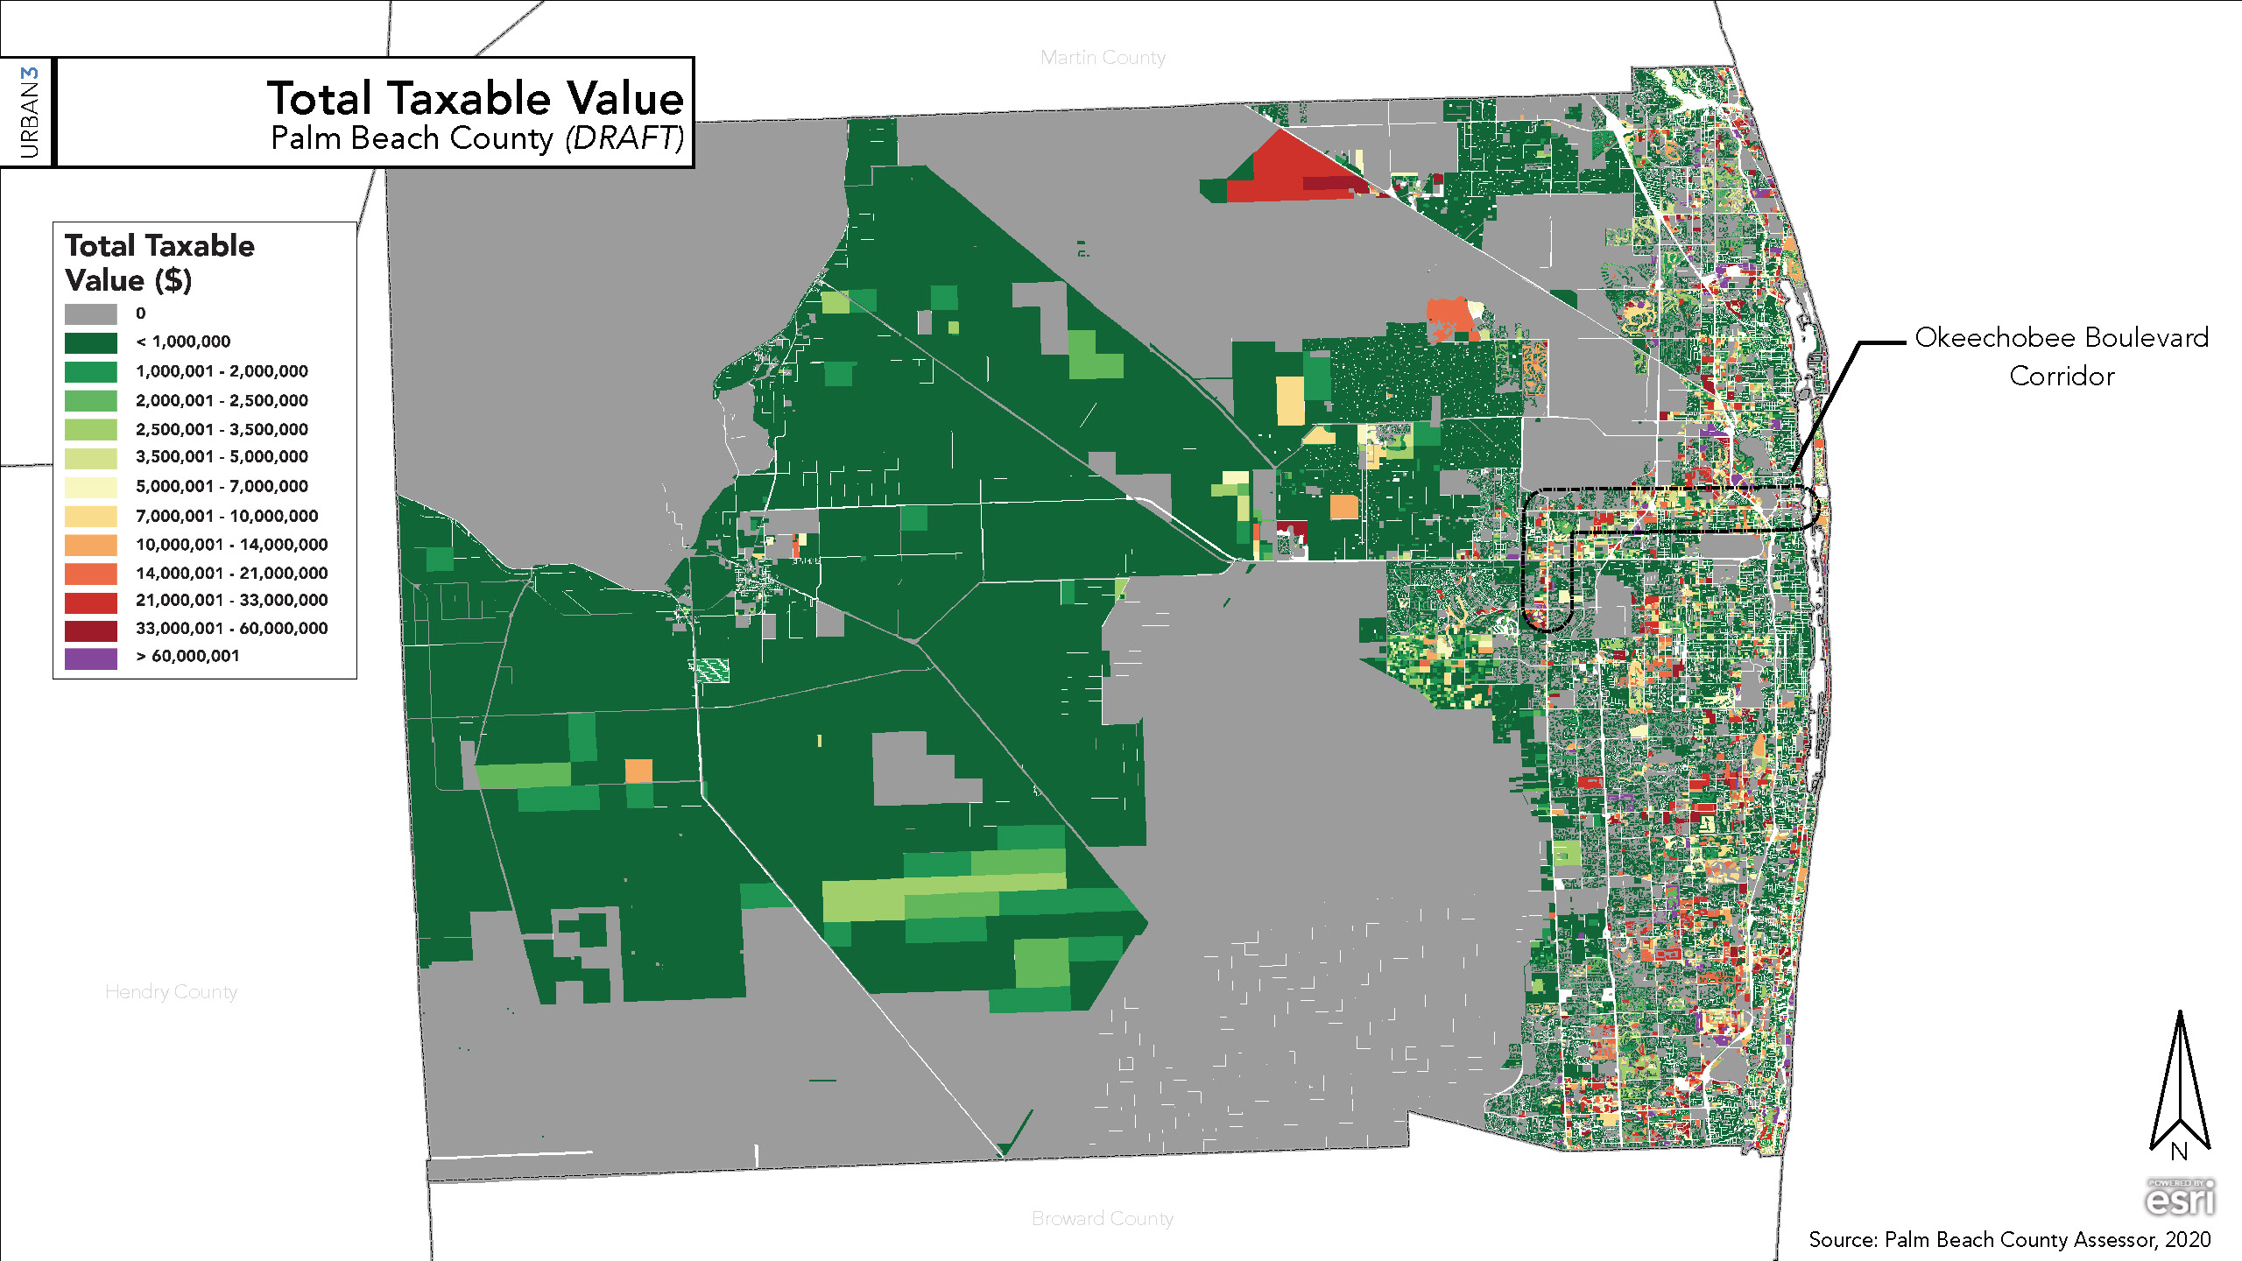
Palm Beach County TOTAL Taxable Value
9

Slide 10
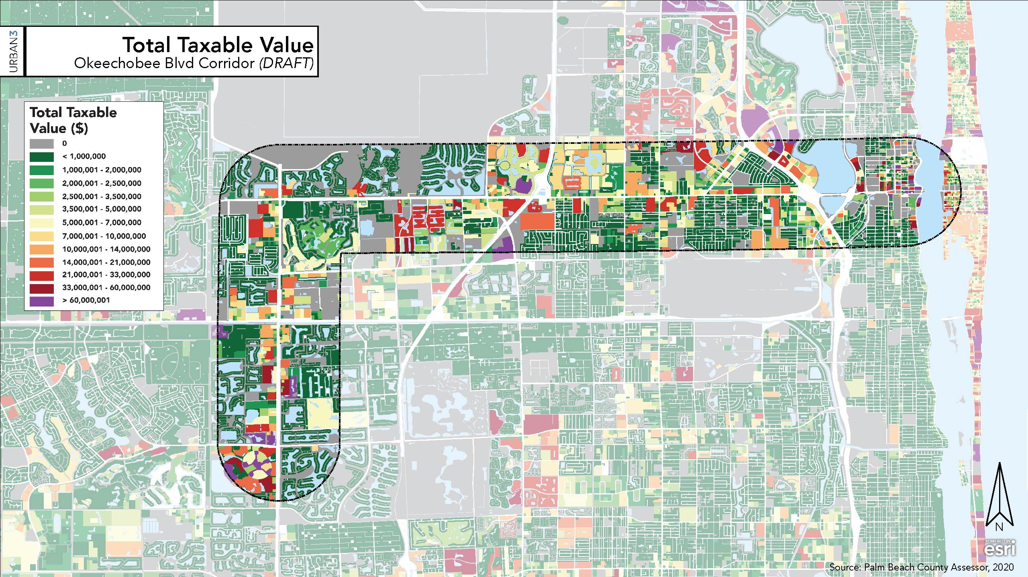
Okeechobee Blvd Corridor TOTAL Taxable Value
10

Slide 11
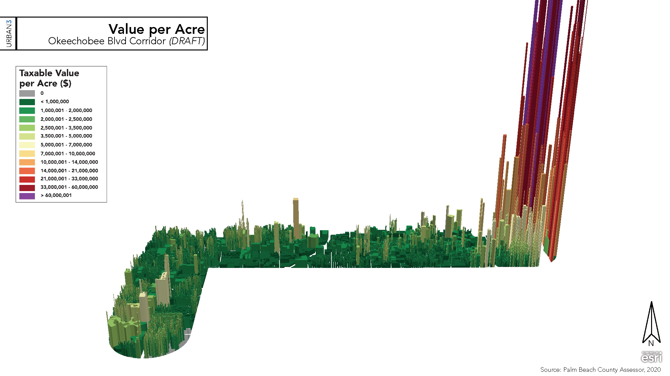
Okeechobee Blvd Corridor Value per Acre
11

Slide 12
HIA Steps & Key Considerations
Screening
Scoping
Assessment
Recommendations
Reporting & Monitoring
Evaluate project & its value based on screening criteria.
Define scope of investigation, research questions, and methodology for the HIA.
Assess impacts of proposed alternatives and specify direction and magnitude of impacts.
Create recommendations in line with health promotion strategies.
Present HIA to the community and evaluate the impacts on decision-making process.
1
2
3
4
5
Stages adapted from Human Impact Partners, 2011
Notes:
Provides clarity on how proposed multimodal alternatives will influence health in the community
Advocates for alternatives that optimize health equity and mitigate disparities in accordance with TPA’s intended outcomes
Measures health holistically, accounting for the array of factors that directly and indirectly impact health

Slide 13
Screening Criteria
Outline Project & Timing
Stakeholder Interest
Assess multimodal alternatives in terms of their impact on health
Timeline June 2021 - February 2022
Four (4) Technical Steering Committee Meetings
Three (3) Public Meetings
Detail Potential Impacts of HIA Findings
Analyze & Describe Potential Health Impacts
Balancing optimal transit alternatives with beneficial health outcomes
Socio-economic characteristics, Economic Stability, Pedestrian & Bicycle Safety, Climate & Built Environment
Improved neighborhood cohesion
Enhance collaboration among community members

Slide 14
Pathway of Potential Health Impacts
Economic Stability
HIA
Pedestrian & Bicycle Safety
Climate & Environment
Sources: TPA, 2020 & EPA, 2021

Slide 15
Baseline Traffic Inventory
Daily
2019 (Base Year)
All segments operate at LOS C/D
2045 (LRTP Horizon Year)
One segment operates at LOS F
Okeechobee Blvd from I-95 to Australian Ave ⁽¹⁾
Peak Hour
2019 (Base Year)
All segments operate at LOS C/D
2045 (Horizon Year)
Segments that operate at LOS F
Okeechobee Blvd from SR 7 to Military Trail
Okeechobee Blvd from I-95 to Australian Ave ⁽¹⁾
(1) = free flow segment

Slide 16
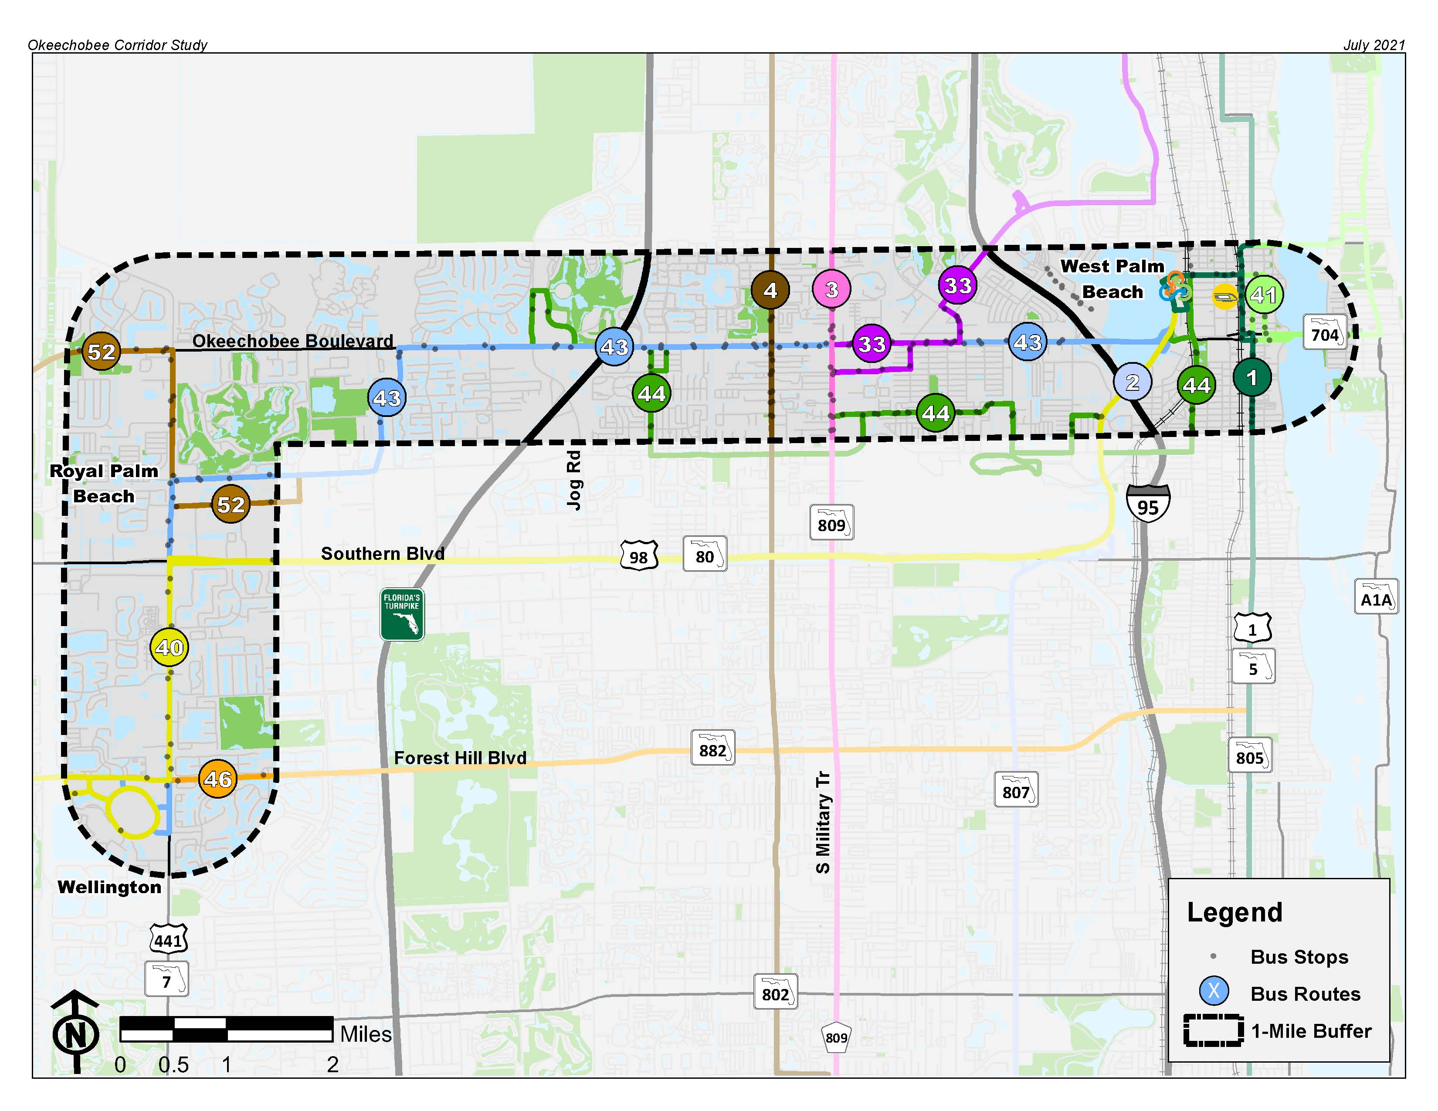
Transit
Two transit hubs
The Mall at Wellington Green
Intermodal Transit Center
Route 43
Okeechobee Blvd trunk line
No service west of Benoist Farms Road
Highly productive route
30-minute headways

Slide 17
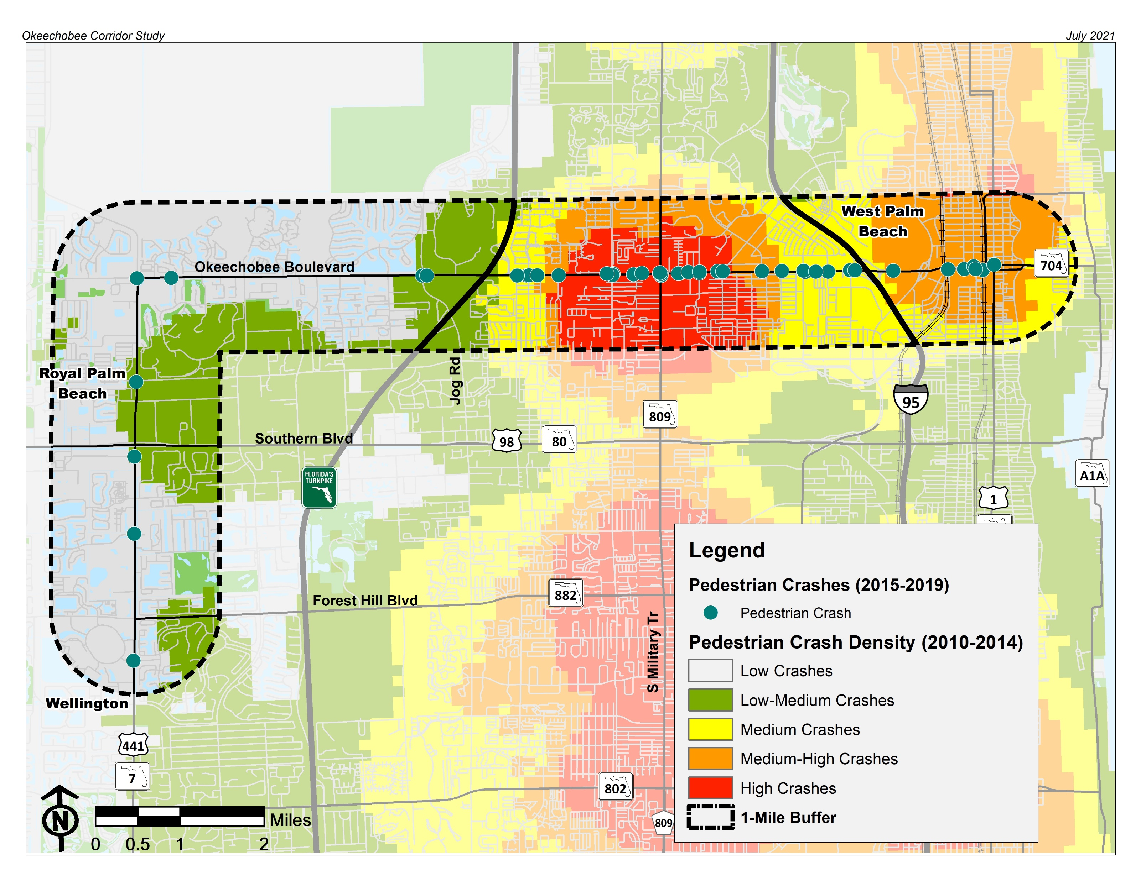
Safety
Crash Data Analysis
Review of Pedestrian and Bicycle Crashes
Pedestrian High Crash Corridor between the Turnpike and I-95

Slide 18
Right-of-Way
SR-7
190-280 feet of ROW
Example shown: Forest Hill Blvd to Southern Blvd
Existing

Slide 19
Right-of-Way
Okeechobee Blvd, west of Turnpike
230 feet of ROW
Existing

Slide 20
Right-of-Way
Okeechobee Blvd, between Turnpike and I-95
130 feet of ROW
Existing

Slide 21
Right-of-Way
Okeechobee Blvd, east of I-95
152 feet of ROW
Existing

Slide 22
Right-of-Way
Okeechobee Blvd, east of Tamarind Ave
210 feet of ROW
Existing

Slide 23
Data Gathering
Missing sidewalk east side of SR 7
Programmed TIP projects
Laneage
Bicycle facilities
Sidewalk facilities
Bus stops
Right-of-way boundary
Adjacent land use
TIP Project (Resurfacing FY 2023)
Bus stop with no sidewalk
EXAMPLE: SR 7 north of Belvedere Road
8 lanes transitions to 6 lanes

Slide 24
Existing Conditions Findings Summary
Project corridor connects two transit hubs
Current transit service is productive, but limited
Over half of project corridor is within a suburban context
Wide right-of-way in suburban areas west of Turnpike
Plenty of traffic flow capacity, but with some future concerns
Need to determine appropriate allocation of space in ROW
Traffic safety concerns in urban general area
Existing non-motorized facilities do not support promoting alternate transportation
Development opportunities along the corridor such as:
Okeechobee/SR 7 SE corner could be transit-supportive with park-and-ride

Slide 25
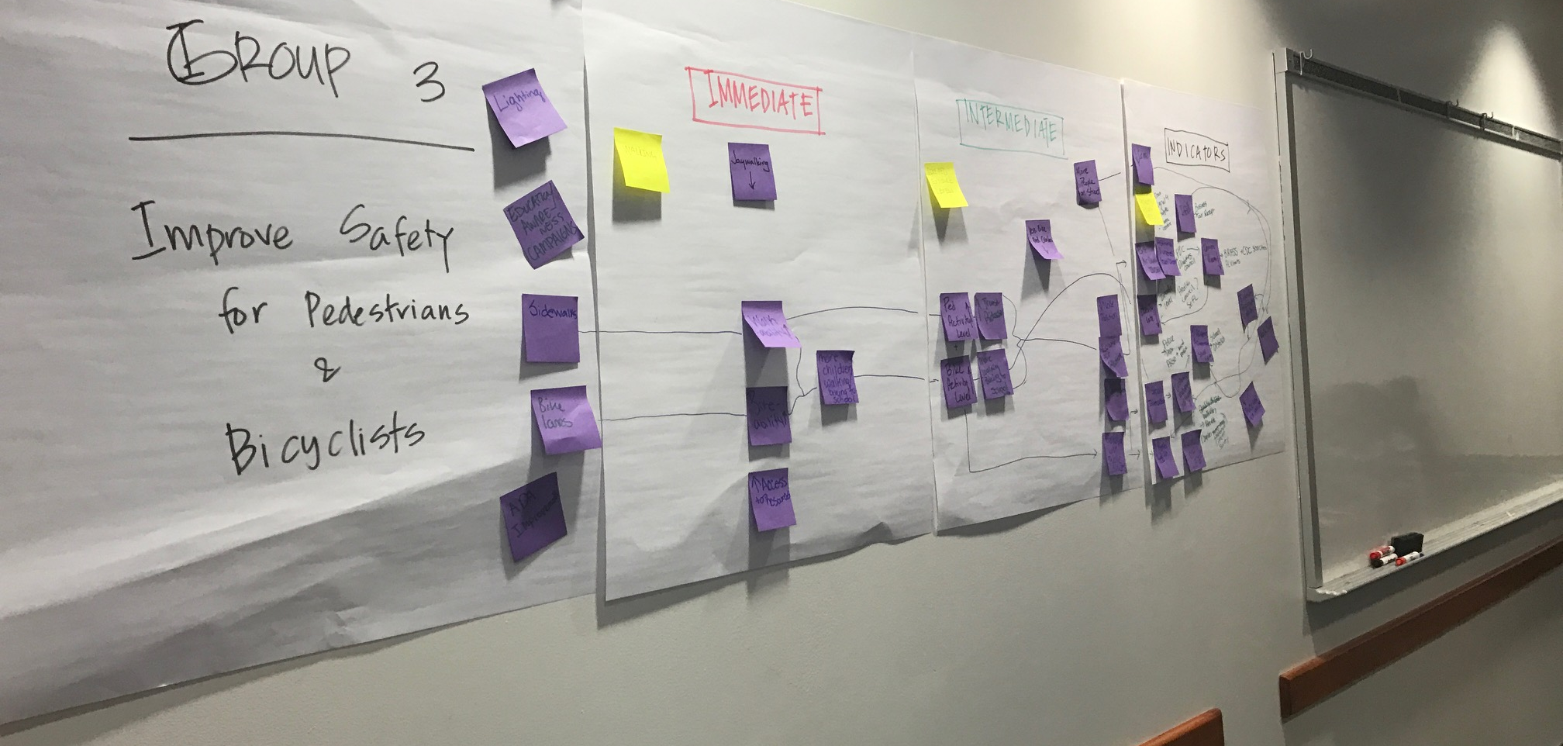
Discussion

Slide 26
Study Timeline
SPRING 2021
1st SAWG & HIA Meetings;
Stakeholder & Field Interviews
SUMMER 2021
2nd SAWG & HIA Meetings;
1st Public Outreach Event
FALL 2021
3rd SAWG & HIA Meetings;
2nd Public Outreach Event
WINTER 2021/22
4th SAWG & HIA Meetings;
3rd Public Outreach Event

Slide 27
Next Steps
Technical Tasks:
Issues and Opportunities technical analysis
HIA coordination and analysis
Land Use coordination and analysis
Next/Upcoming Meetings:
Week of August 16th - Stories of the corridor gathering
August 19th - Issues & Opportunities Public Workshop #1
August 24th and 25th - Land Use & Economic Development Working Group Meetings
August 18th - HIA Working Group Meeting
October 14th - SAWG Meeting #3
27

