Slide 1
HIA
Health Impact Assessment
Notes:
The project team conducted a Health Impact Assessment (HIA) in order to evaluate and provide recommendations that promote positive health outcomes and health-equity for community members that live, work, and play in the study corridor of Okeechobee Blvd and SR7. HIAs are developed under a highly collaborative and democratic process. Through listening to feedback from those that reside in the study area, the HIA approach valued engagement from affected populations. In combining evidence-based strategies with commentary from stakeholders, policy makers, and community members, performance of this HIA helped to foster a broader understanding of the unique challenges faced by the study corridor population, particularly for vulnerable groups (Human Impact Partners, 2011).
Existing conditions of the study population identified groups with unique transportation needs (e.g. aging adults, children, people living with disabilities) that may be underserved by current transportation infrastructure along the corridor. In light of these special considerations made toward socially vulnerable groups, the Transportation-Alternative Health Analysis scale was developed to weigh the potential health impacts associated with specific design elements in terms of air quality and resilience, physical activity, and road safety. The larger analysis was also informed by a modeling tool called the Integrated Transport and Health Impact Model, or ITHIM, which measures the health impacts of changes to active travel behaviors. Importantly, this HIA is the first of its kind to recalibrate the ITHIM, traditionally a gold standard practice at the regional- and state-level, and effectively implement the tool in a corridor-level setting.
In the next few slides, we will be reviewing results from the HIA, including findings from the Transportation-Alternative Health analysis and ITHIM projections, and discuss the potential ways through which Light Rail may impact health in the Okeechobee Blvd and SR7 corridor.
[Next slide]

Slide 2
Health Equity and Environmental Benefits of LRT
Light Rail will↑15% in miles spent walking, bicycling and using public transportation.
18% fewer deaths due to Dementia
10% fewer deaths due to Colon Cancer
13% fewer deaths due to Diabetes, Heart Disease, and Stroke
Notes:
Methodology in this HIA was guided by the Integrated Transport and Health Impact Model (University of California, Davis, 2019). Assuming transportation scenarios will increase ridership and active travel (e.g., biking and walking, public transit use), there was an expected redistribution from vehicle miles traveled (VMT) to personal miles traveled (PMT). As such, the ITHIM modeled health impacts across baseline (no-build) and the Light-rail alternative. Projected Boardings for the LRT systems were estimated between 6,300 - 10,300, which informed the percentage shift from VMT to PMT.
During the assessment of existing conditions along Okeechobee Blvd and SR7, particular concerns arose regarding disproportionately poor health outcomes, where some corridor census tracts more than double Palm Beach county rates for heart disease, stroke, nutritional deficiencies, and diabetes. Compared to the baseline of a no-build project, Light Rail was predicted to increase the miles spent walking, bicycling or using public transportation by 15%. This shift was correlated with significant health benefits. With the increase in active travel behaviors, preventable deaths attributed to physical activity-related diseases are expected to decline by implementing the Light rail option. Namely, deaths due to dementia are most significantly reduced, where there is an expected 18% drop, followed by 13% fewer deaths due to Diabetes, Heart Disease, and Stroke. In addition to these conditions, there was an estimated 10% decrease in deaths due to colon cancer.
Next, we will get into other elements of the Light-rail design that were identified for their health impacts.
[Next slide]
[ADDITIONAL NOTES]
Methodology: ITHIM projections are the number of prevented deaths attributable to a specific disease, as measured by shifts in Vehicle Miles Traveled to Personal Miles Traveled. In this case, cause-specific deaths were only available at the Palm Beach County level, so disease specific deaths were averaged per 10,000 corridor residents. The mortality rates predicted for the 15% shift in VMT to PMT were calculated by subtracting the number of prevented deaths from the 3-year average death estimate and dividing by the corridor population, and multiplying by 10,000.
Limitation: Florida specific travel behavior was not available to serve as baselines for vehicle and personal miles traveled. In the absence of this measure a range of values (i.e., mean, minimum, and maximum) were used from California’s travel survey estimates. In addition, Corridor census tract-level deaths were not available. To combat this limitation, we used mortality per 10,000 residents based on a Palm Beach County death numerator and Corridor population denominator. Future work may consider gathering tract-specific deaths by cause for more precise estimation of the Corridor’s health impact.
Diabetes: -12.8% change
Baseline parameter = 39 deaths attributable to diabetes / 10,000 corridor residents
15% shift = 34 deaths attributable to diabetes / 10,000 corridor residents
Heart Disease: -13.05% change
Baseline parameter = 452 deaths attributable to heart disease / 10,000 corridor residents
15% shift = 393 deaths attributable to heart disease / 10,000 corridor residents
Stroke: -13.04% change
Baseline parameter = 138 deaths attributable to stroke / 10,000 corridor residents
15% shift = 120 deaths attributable to stroke / 10,000 corridor residents
Colon Cancer: -9.67% change
Baseline parameter = 31 deaths attributable to colon cancer / 10,000 corridor residents
15% shift = 28 deaths attributable to colon cancer / 10,000 corridor residents
Dementia: -18.42% change
Baseline parameter = 38 deaths attributable to dementia / 10,000 corridor residents
15% shift = 31 deaths attributable to dementia / 10,000 corridor residents

Slide 3
Health Equity and Environmental Benefits of LRT
Light Rail will↑ width of Sidewalks and Bicycle lanes
↑
↑
Access to businesses
Safety
↑
↑
Daily exercise requirements
Connectivity
Notes:
The associations between transportation design and health outcomes are well defined. Differences in terms of sidewalk width, bicycle lanes, travel lanes, buffer zones, median, and transportation types were compared between the no-build and Light Rail alternative in the Transportation-Alternative Health Analysis. In this slide, we are looking specifically to the increase in width for the sidewalk and bicycle lanes compared with current infrastructure in the study corridor.
As it currently stands, only about 11.3% of the corridor may be considered walkable. Importantly, wider sidewalks and bicycle lanes promote pedestrian and bicyclist activity through related mechanisms. Both design features, such as broader walkways, and increased space between oncoming traffic and bicyclists, increase the perceived safety and desirability of walking or bicycling along such areas, and is associated with a greater proportion of the population meeting their daily exercise requirements, and a reduced BMI. Improvements made to both pedestrian and bicycle facilities in the Light Rail alternative were also associated with enhanced business activities, that is shopping, access to essential goods and service, and increased spending at businesses within the network. In addition to these considerations, 35% of the study population are either under 18 or over 65 years old, both of which entail special considerations in terms of transportation access and connectivity that may be effectively addressed through implementation of LRT.
[Next slide]

Slide 4
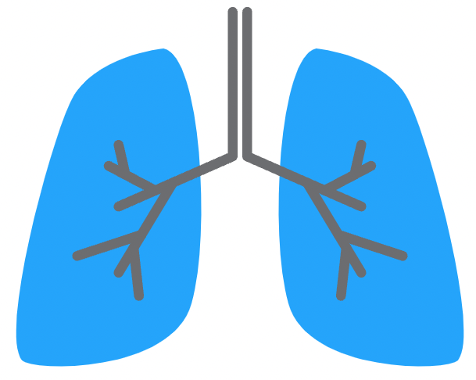
Health Equity and Environmental Benefits of LRT
Light Rail technology↑ efficiency, air quality, and green spaces
↑
↑
Vehicle usage
Life Expectancy
↑
↑
↑
Respiratory illnesses
Heat island effects
Social connectedness
Notes:
From an environmental perspective, transit designs that alter travel behaviors, namely, a reduction in single-occupancy vehicle trips, directly influence the amount of carbon dioxide emissions released into the air resulting from the combustion of petroleum-based products, most commonly gasoline and diesel (United States Environmental Protection Agency, 2021). Namely, the reduction in vehicle emissions that result from engaging in walking, bicycling, and public transportation are outcomes of particular interest for the Light Rail alternative that positively impact air quality and resilience.
With fewer vehicle emissions, literature well establishes links to greater life expectancy and a decline in respiratory illnesses, such as asthma, COPD, and lung cancer, which may be further ameliorated in the Light rail alternative through the availability of green spaces. In addition to providing as a buffer for pedestrians, transit users, and bicyclists alike, landscaping and tree canopy coverage are useful in reducing the burden of heat island effects and serve as a mitigation strategy to combat the impacts of a changing climate.
Use of eco-friendly transit designs like LRT are best suited for the Okeechobee Blvd and SR7 corridor given their ability for high ridership capacity. With increased accessibility, social connectedness among community members is another expected outcome of LRT technology.
Given the findings in this HIA, LRT holds significant potential to promote health and wellbeing for the study corridor population. Importantly, similar sentiments are well documented by Valley Metro in Maricopa County, Arizona. In a 10-year follow-up study of their LRT system, results indicate that the potential for long-term health benefits of LRT implementation may warrant the up-front costs. Since its implementation, over 35,000 jobs have since been created in ½ mie of the Valley Metro’s LRT (Valley Metro, n.d.). Other benefits include improved access to education and areas of interest in a single trip, a reduction in bicycle and pedestrian crashes, and increased affordability within the LRT corridor when compared with the average for Maricopa County (Valley Metro, n.d.). In light of these conclusions, it is recommended that the Palm Beach TPA consider the monitoring of some of the potential health impacts identified during the HIA to inform the real life effects of the LRT system on the state of health and health equity in the Okeechobee Blvd and SR7 corridor.

